Slide 1


BANK Management System
JINNAH UNIVERSITY FOR WOMEN
Department of Computer Science and Software Engineering
Presented by:
Hareem Imran
Insharah riaz
Ujala shah
Presented to: Ms. Sadia

Slide 2

agenda
Objectives
Bank management system
Features of the system
Functional requirements
Non-functional requirements
diagrams
Use case diagram
Class diagram
Activity diagram
Prototypes of bank management system
conclusion
GROUP MEMBERS

Slide 3
OBJECTIVES:
To build an optimal system of interaction between the elements of banking mechanism with user friendly environment.
Through participative management, increase productivity.
To improve the human resources of the bank.
To improve organizational cultural and value system.

Slide 4
BANK MANAGEMENT SYSTEM:
The banking system must be adequately managed to ensure its seamless operation.
Banking management is responsible for all aspects of banking, including risk management, policy design, profit monitoring, and other responsibilities.
To optimize profit, a bank management system ensures proper oversight of banking processes.
4

Slide 5
Features of the system:
When a user will register into the system first their NIC will be checked through NADRA for verification and confirmation. Same goes for the employee as well.
When an employee will login to the account their employee id will be checked through bank then will be able to proceed further.
It can run on any provided browser.
It has the option of FORGET PASSWORD for employee and user as well.
It Manages all the transactions.

Slide 6
Functional requirements:
As a branch manager, I must be able to view the accountants and employee’s information.
As an employee, I can access my profile and able to view my information
As an accountant, we must be able to view the customer information and update their accounts.
As a customer, we have to be able to go through the branch of a bank, we can excess.

Slide 7
Non-functional requirements:
The form does not take that much time.
Users can access their info 97% of the time without the failure.
Customers are able to check own account, deposit the amount, and can also transacted.
The forms are user friendly and easy to use.
The system shall maintain data integrity by keeping backups of all updates to the database for every record transaction
When the editing the code for customer and employee’s profile page, the resting of the form stays up and running.
Up to 500 customers can request for an account. Up to 1,000 accounts can be managed.

Slide 8
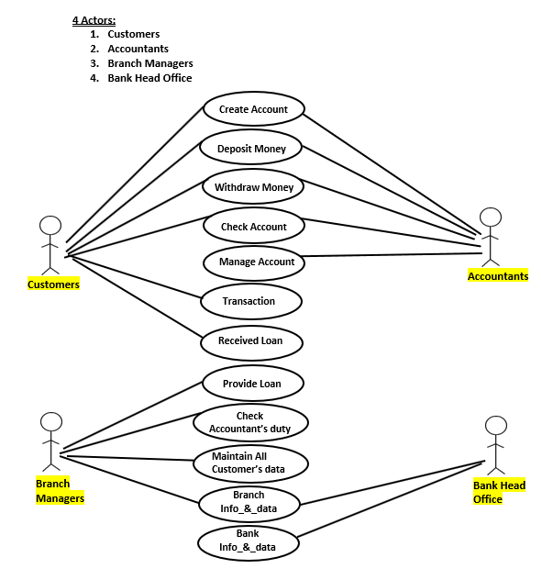
Diagrams:
Use case diagram

Slide 9
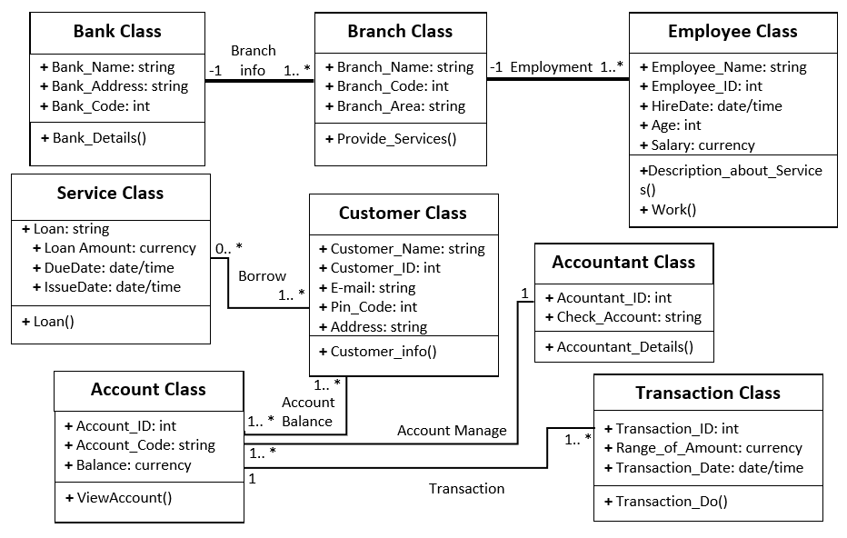
Class diagram

Slide 10
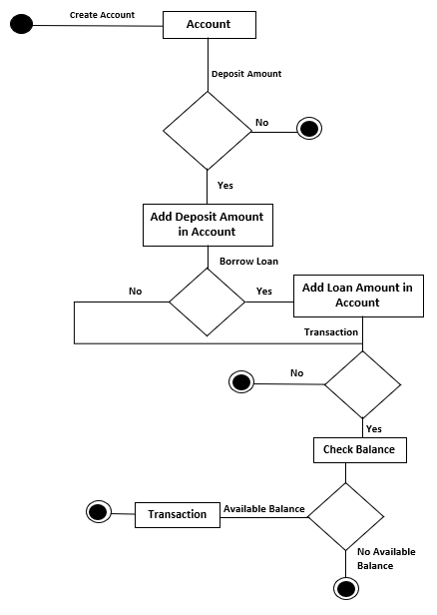
Activity diagram

Slide 11
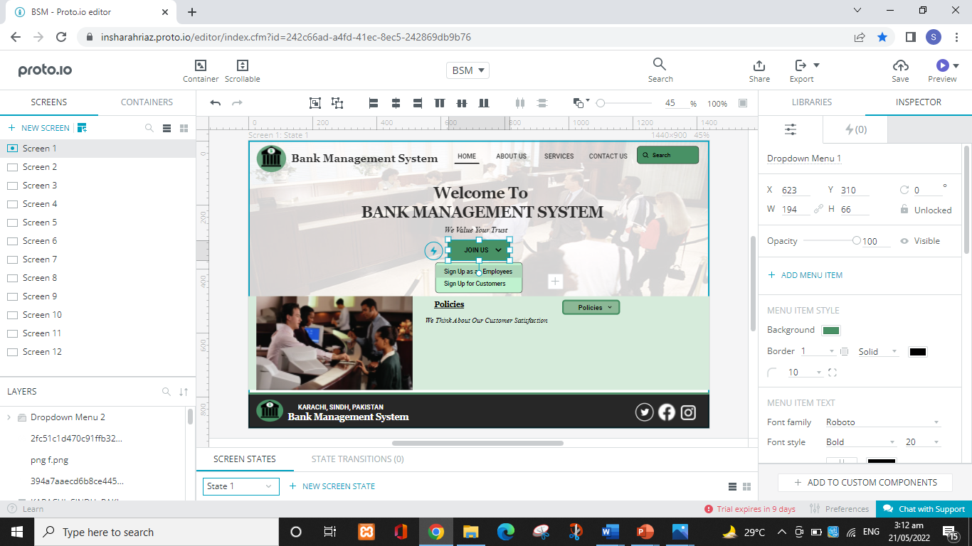
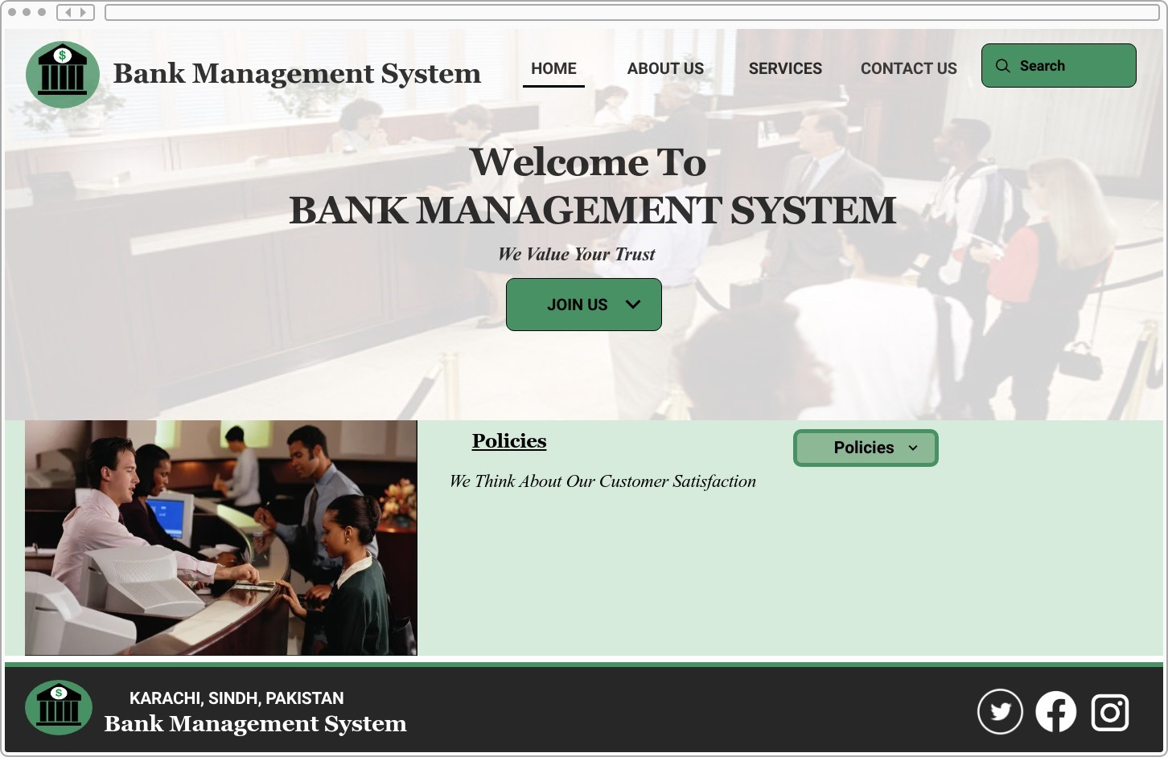
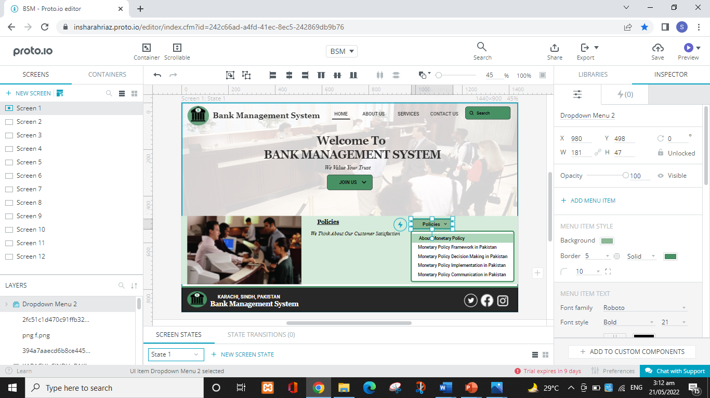
Prototypes of bank management system
Home page
11

Slide 12
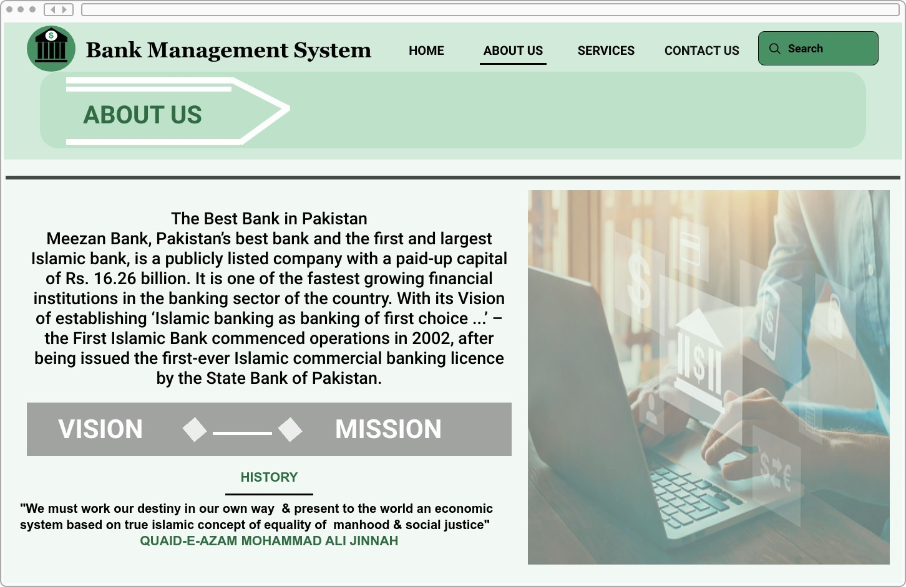
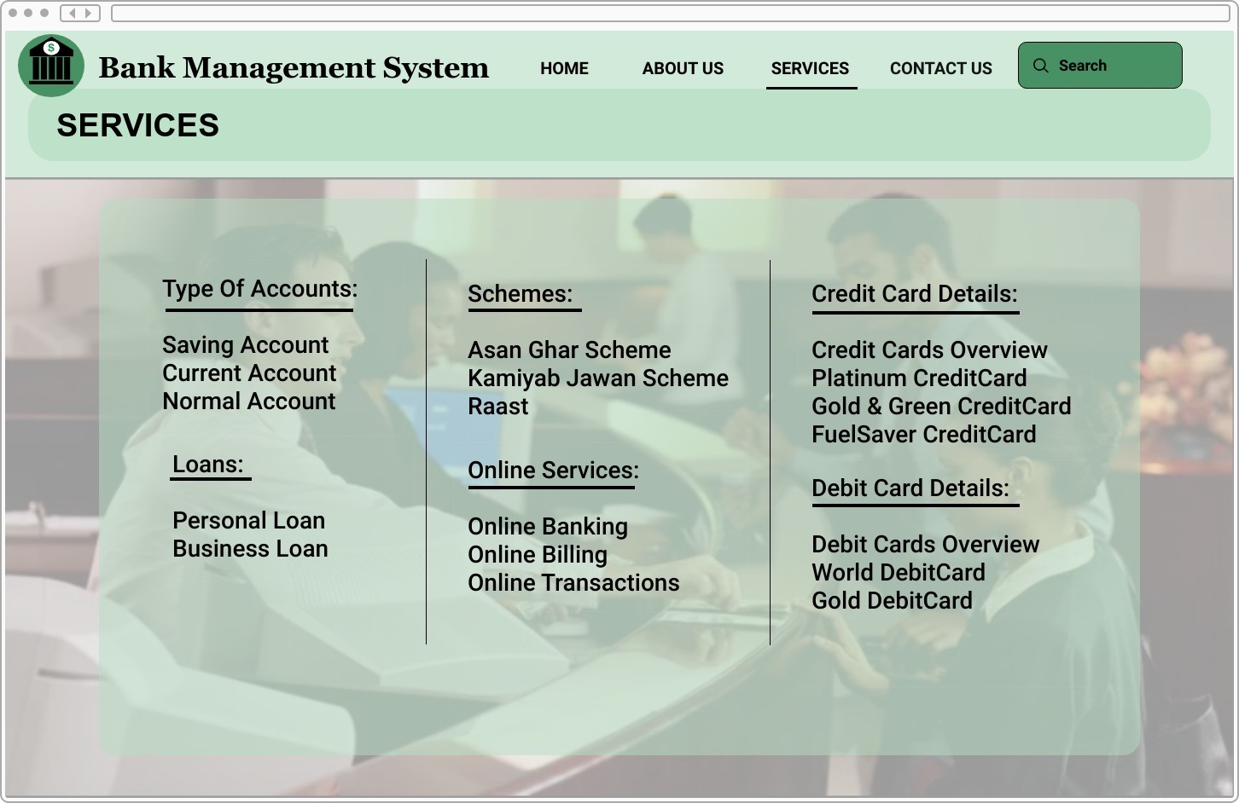
About us & services page
12

Slide 13
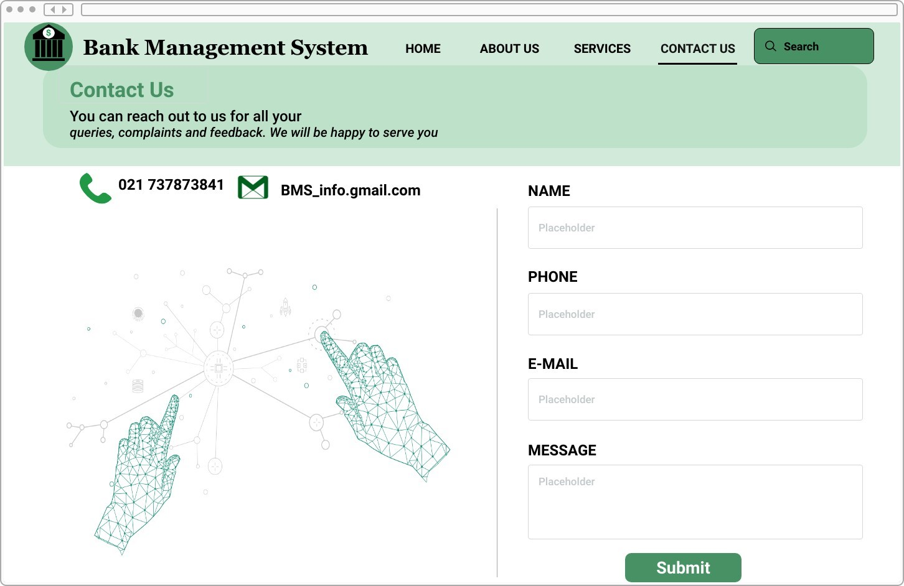
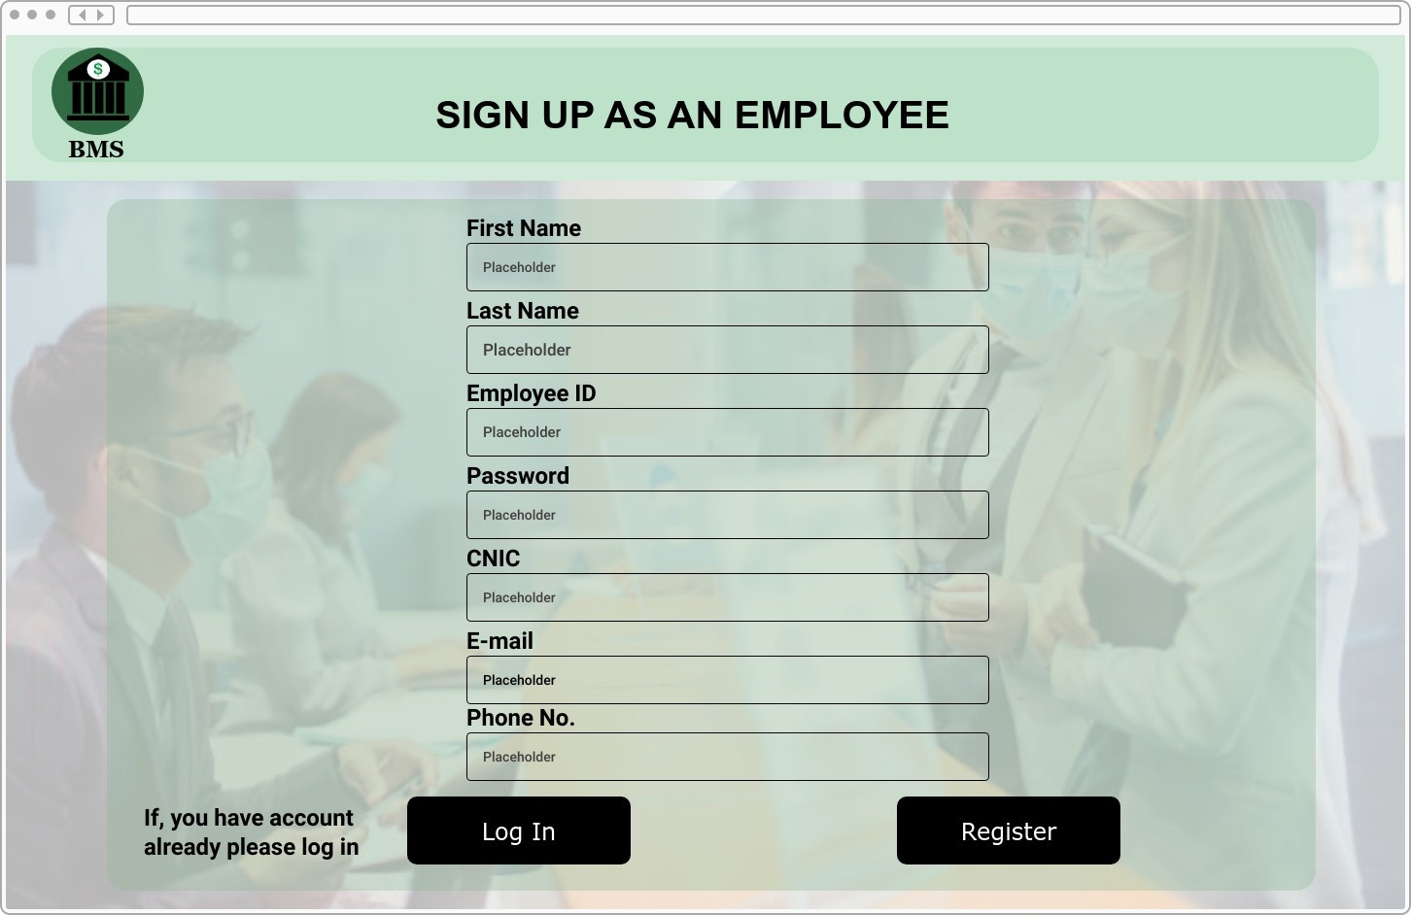
contact us, register (employee) page
13

Slide 14
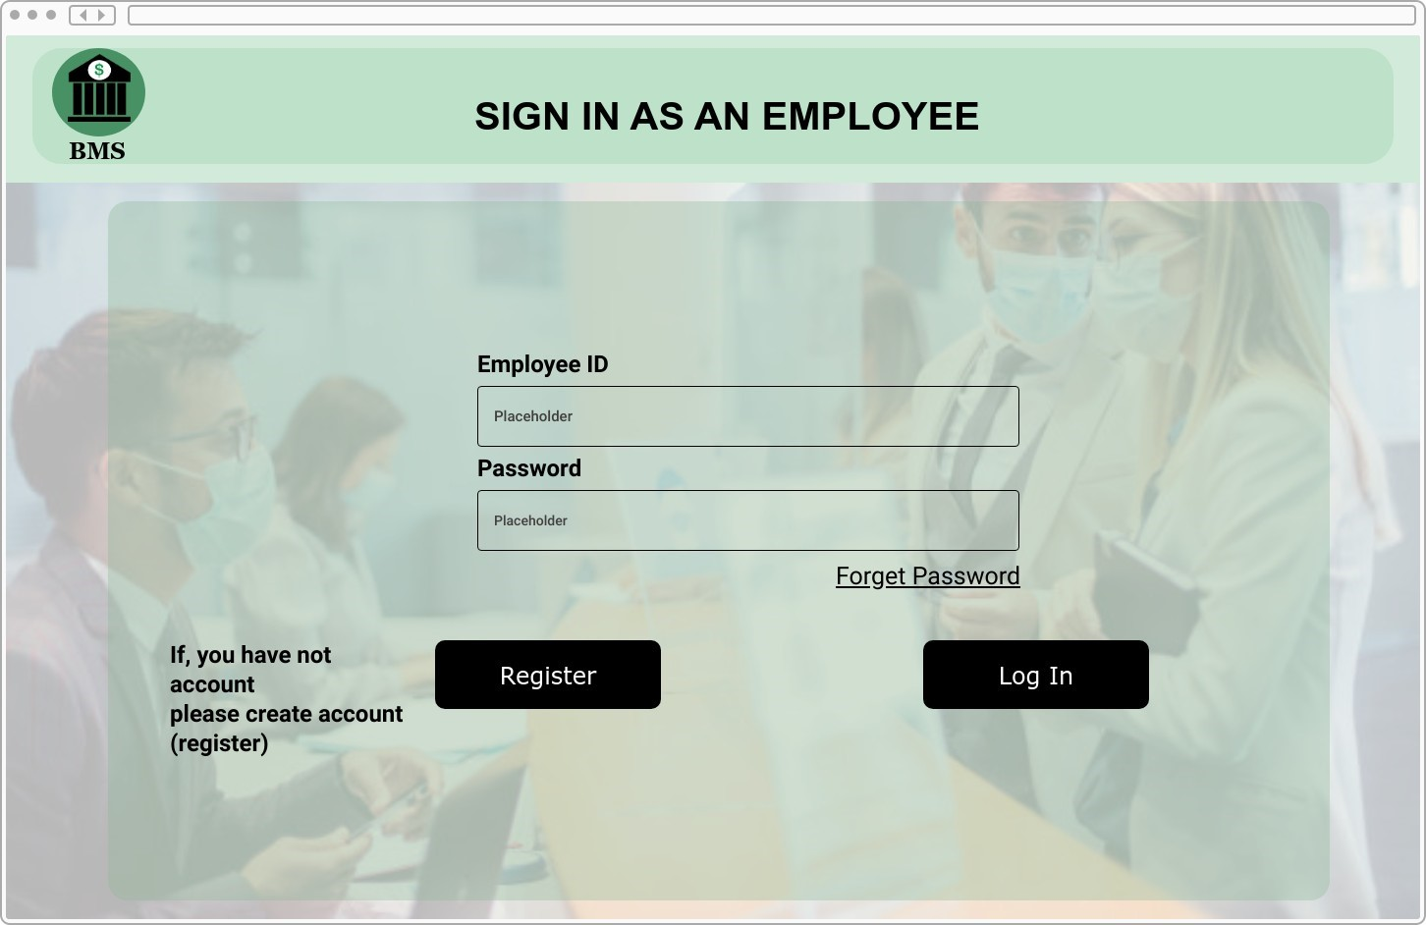
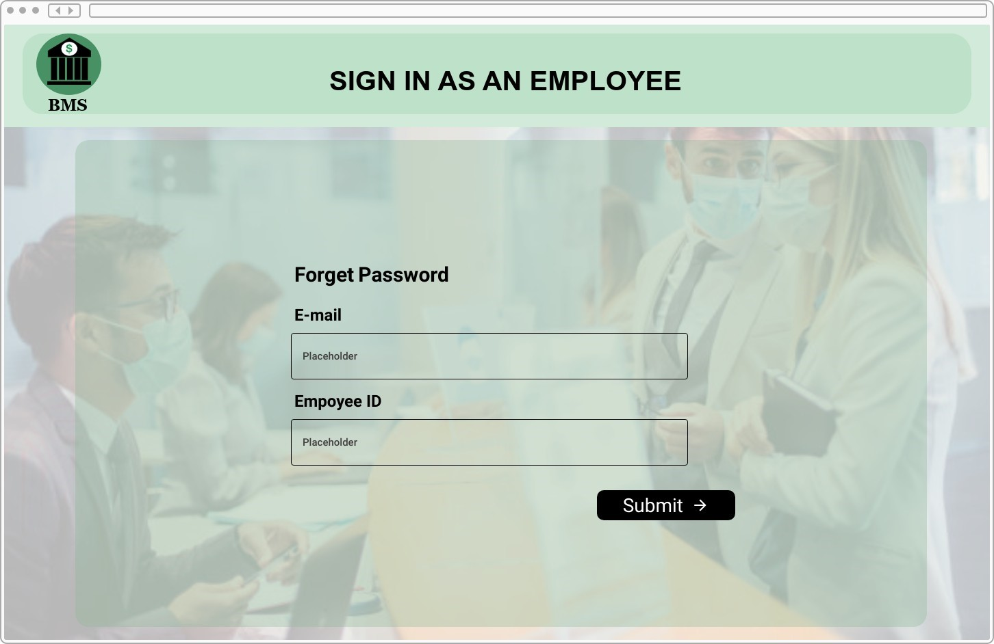
Log in & forget password (employee) page
14

Slide 15
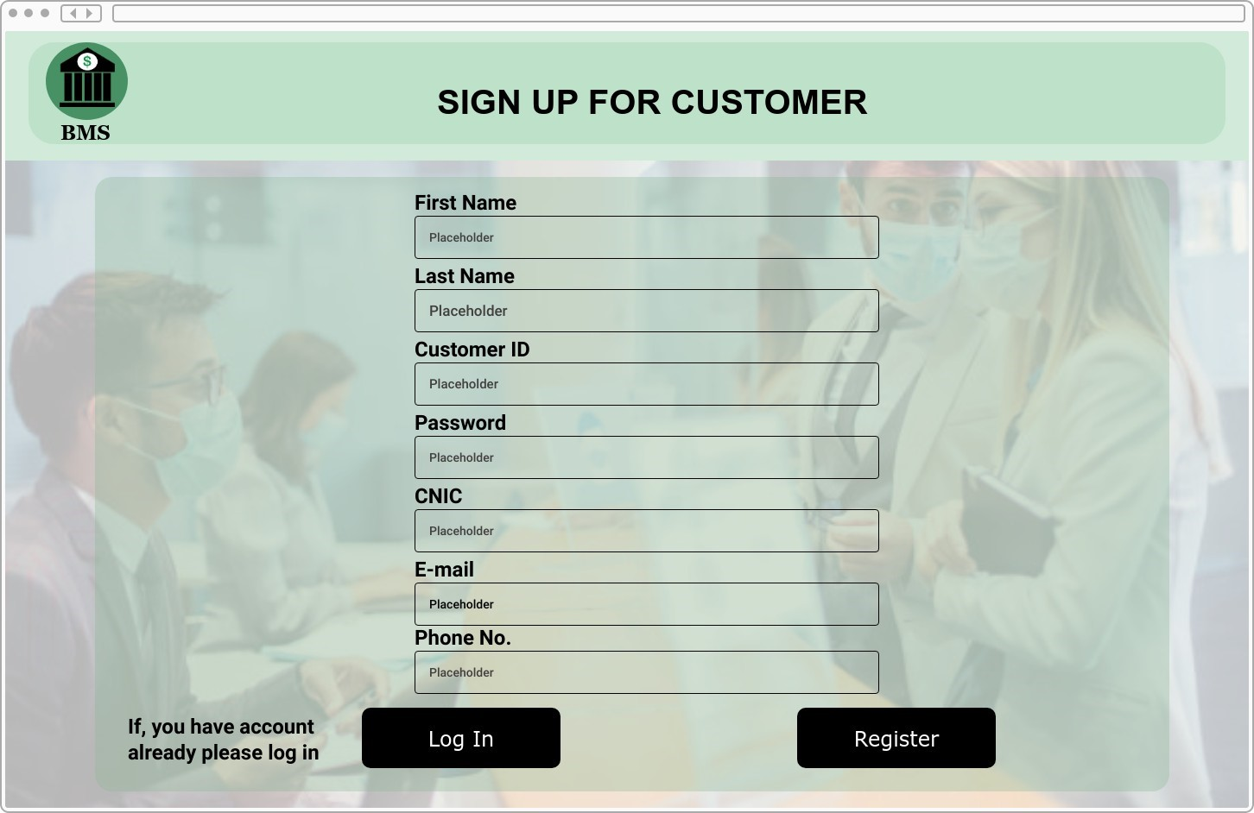

register & log in (customer) page
15

Slide 16
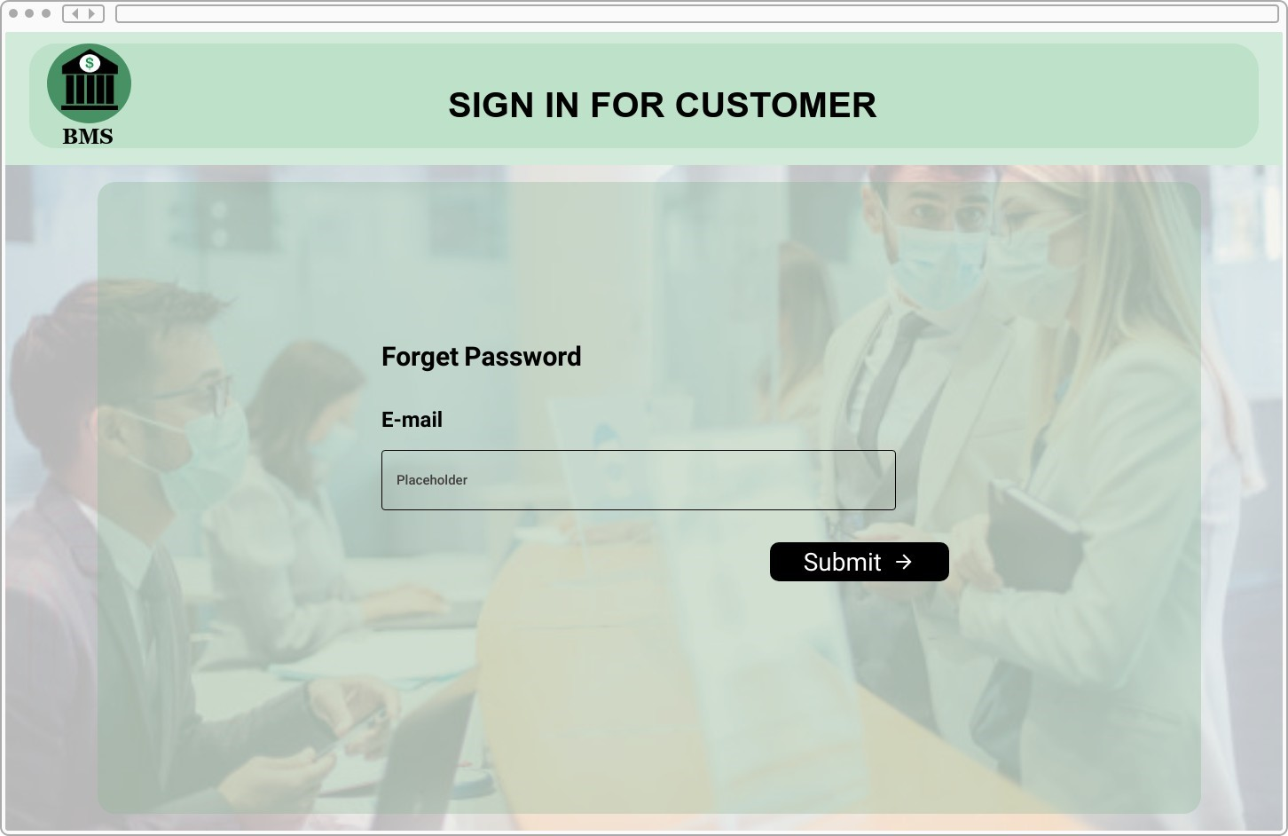
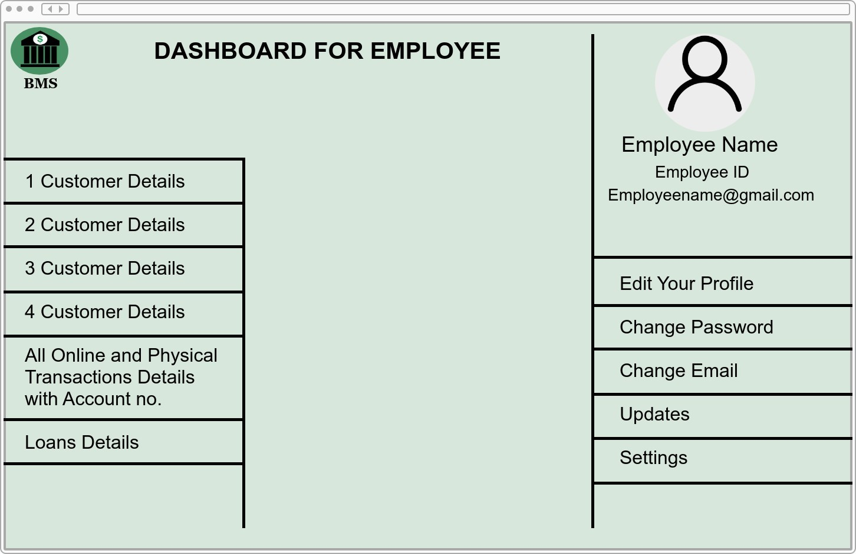
forget password (Customer) & dashboard (Employee) page
16

Slide 17
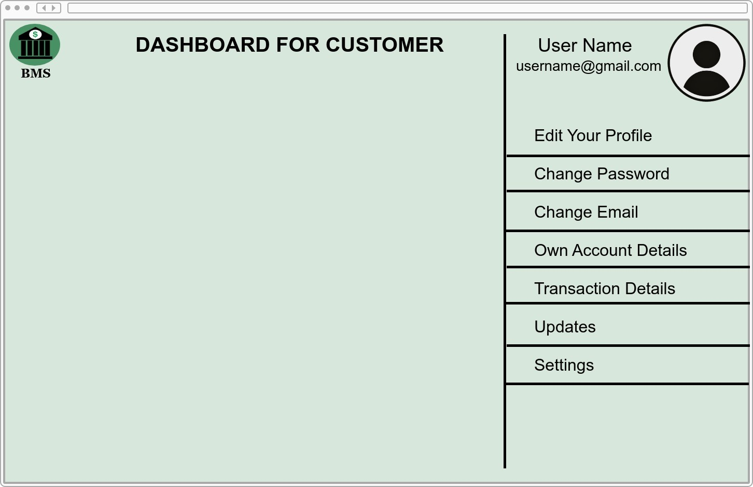
dashboard (Customer) page
17

Slide 18
Conclusion:
A bank management system is a virtualization of financial transactions. Manual processes are employed in banking systems, however when we use an online banking system, we use a virtualization technique that eliminates manual processes and converts them to automated processes. If a user can make a transaction in a bank management system, that transaction is available in any place where the user can also link their identity card to their account and quickly move branch locations. Bank management systems save time and are more accurate than manual bank systems.

Slide 19



GROUP MEMBERS
HAREEM IMRAN
(juw-08057)
(Introduction, Conclusion)
INSHARAH RIAZ
(juw-06692)
(Diagrams, Screens)
UJALA SHAH
(juw-07183)
(Functional & non-functional requirements, Features)

Slide 20

Thank you!

